Slide 1
COVID-19 Analysis
By
Kerolos Nasser Ayad
Supervised
Eng. Ahmed Reda Eng. Amr Saleh

Slide 2
Agenda
Extraction
transformation
loading
Visualization
workflow diagram
Tools

Slide 3
extraction
Built a data pipeline using Apache Airflow to Extract Covid-19.csv from Local Machine to Data Lake like S3 Bucket as Object.

Slide 4
transformation
Make task in airflow Dag to Clean Data from Null Values by Using Pandas library in Python.
Delete extra rows didn't contain of data.

Slide 5
Loading
After Clean data I Load csv to S3 Bucket As object.
Then Create Database in redshift Cluster named covid_db.
Then Create Table named covid_19 to load data into.
In addition to used COPY Command to Load data from S3 to Redshift in covid_19 table.

Slide 6
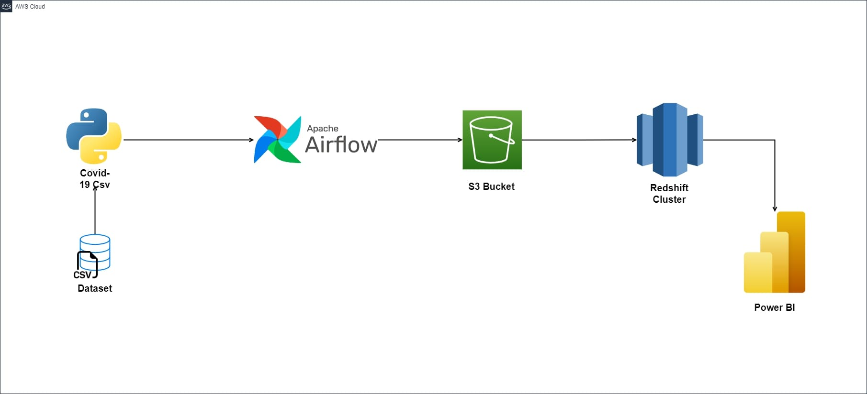
workflow diagram

Slide 7
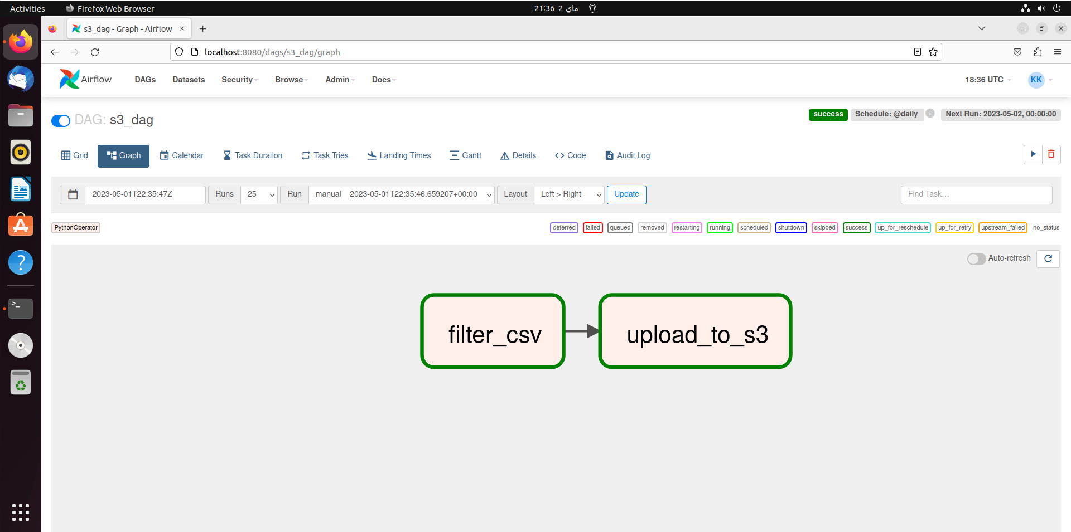
Dag

Slide 8
Tools
Apache airflow: is an open-source platform for programmatically orchestrating, scheduling, and monitoring complex workflows or data pipelines. It provides a way to define, execute, and manage workflows as a directed acyclic graph (DAG) of tasks, where each task represents a unit of work that needs to be executed.
S3 Bucket: is a storage resource provided by Amazon Web Services (AWS) that allows you to store and retrieve data in the cloud. It is a scalable, durable, and highly available object storage service.
RedShift: is a fully managed data warehousing service provided by Amazon Web Services (AWS). It is designed to efficiently analyze large volumes of data using a massively parallel processing (MPP) architecture.
Power BI: is data visualization platform. It allows users to connect to various data sources, transform and analyze data, and create interactive visualizations and reports.

Slide 9
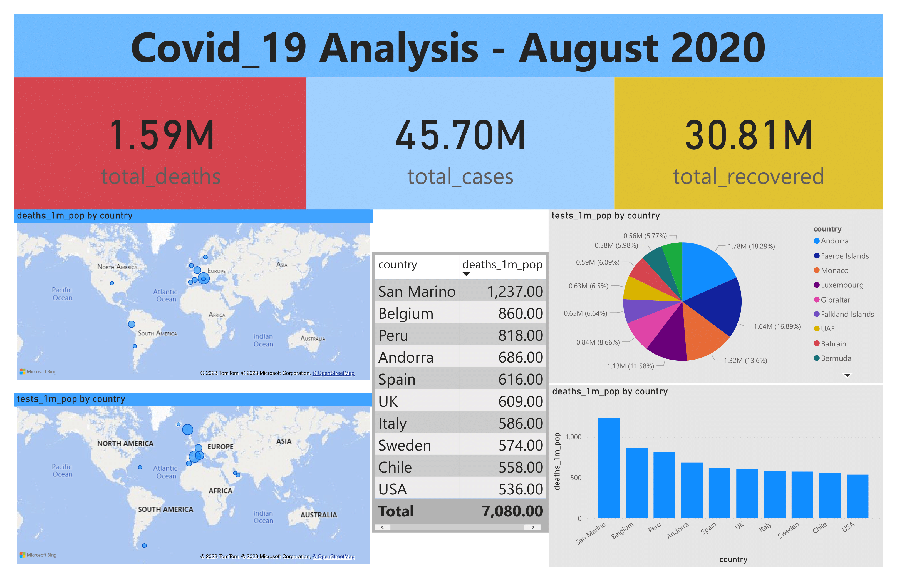
Visualization

Slide 10
Project Resources
GitHub: https://github.com/Kerolos-Nasser/covid-19-airflow-etl-project
YouTube: https://youtu.be/o3zs3eF8MkE

Slide 11
Thanks

